Slide 1
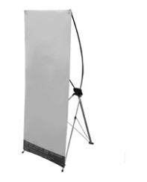
Input paper title here
Paper No.
Affiliation’s Logo Goes here if any
Authors and affiliation
Materials Provided by the Organizer:
1) X Racks & Base Fabric Canvases (160 cm × 60 cm), portrait (vertical) format
2) Adhesive Tapes or Clamps
Poster Printing:
Please send your poster back to the conference committee via e-mail: icbeb@icbeb.org.
For the presenters providing their poster by September 20th, 2019, Conference will print the posters for free.
If you failed to complete the poster by that time, please print the poster by yourself and bring it to the conference. Do not change the page size. Please make four holes in the four sides of the poster, which will make it easy to be displayed.
Best Poster(s) Selection
Originality, Novelty, and Layout of the poster;
Onsite interpretation from the presenter.
Note:
*Presenter is required to stand by his/her poster. All presenters are responsible for removing their posters after presentation time.
Poster Sample

